Slide 1
Copyright © 2014 by Software Craftsmanship Guild.
All rights reserved. No part of these materials may be reproduced, distributed, or transmitted in any form or by any means, including photocopying, recording, or other electronic or mechanical methods, without the prior written permission of the Software Craftsmanship Guild. For permission requests, write to the Software Craftsmanship Guild, addressed “Attention: Permissions Coordinator,” at the address below.
Software Craftsmanship Guild
526 S. Main St, Suite 609
Akron, OH 44311

Slide 2
Basic Queries
Software Craftsmanship Guild

Slide 3
Lesson Goals
Be aware of database context
Learn to select data with… the SELECT command!

Slide 4
A Note About Semi-Colons
It is a common best practice to terminate your queries in T-SQL with semi-colons, but in most cases it is optional
I personally tend to not use them unless they are required.
Oh… and SQL is not case sensitive

Slide 5
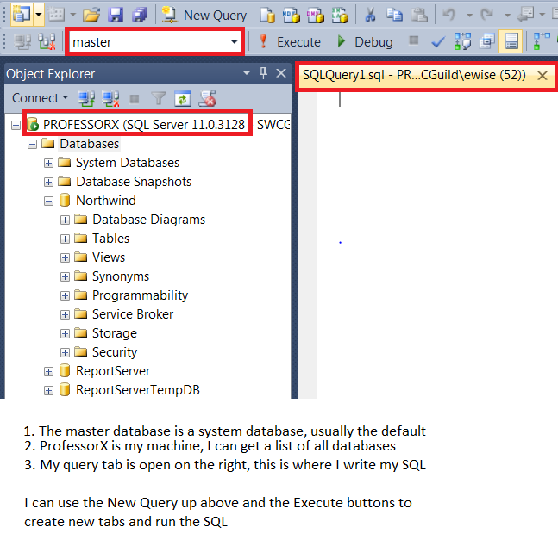
Open SQL Server Management Studio
This is the primary interface for working with SQL Server
Notice the Object Explorer on the left, this allows you to navigate your databases (you can have multiple databases on a server) and drill down into their objects.
IMPORTANT
Always make sure you are in the right database context for the current query window or put a USE <database name> at the top of your query

Slide 6
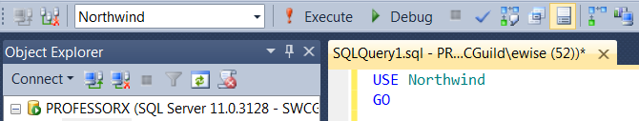
USE
To be safe, we can put the USE statement to switch databases (usually at the top, but we can switch context in the middle of a script as well)
Otherwise you have to remember to pick it in the drop down.

Slide 7
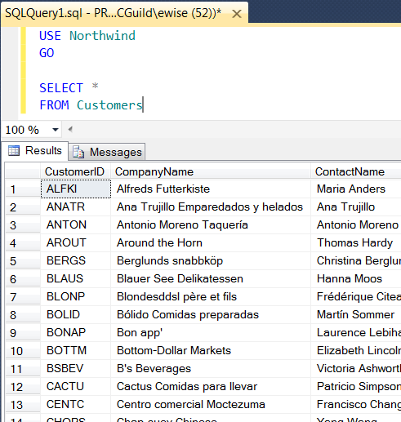
Single Table Queries
When we want work with a database, we write a Query.
The simplest query is the SELECT query:
The syntax for this is
SELECT <fields>
FROM <tablename>
We can either list the columns for the table, or use a asterisk (*) to select all columns.
Check the bottom for some other helpful info (rows returned, db, time elapsed, etc)

Slide 8
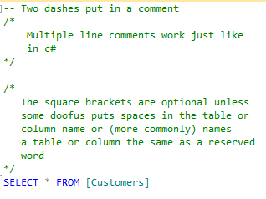
Comments and Brackets

Slide 9
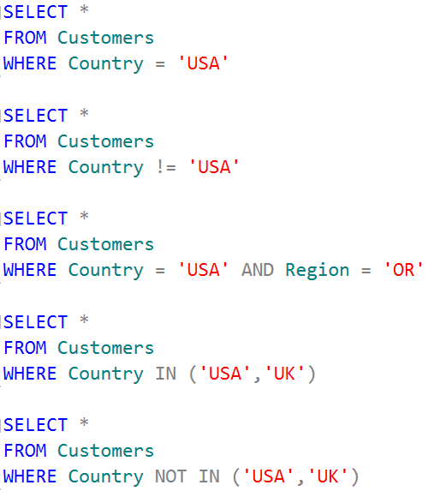
Filtering Results With Where
The WHERE clause is the most common optional command used in SQL. It is used to add criteria to filter the total number of results selected.
In the query to the right we filter only customers whose Country field is set to ‘USA’
Note that for text SQL would like us to use a single quote ‘ character.
The logical statement (Country = ‘USA’) is called a predicate.
Predicates can contain quite a few useful operands as shown to the right.

Slide 10
Lab Exercises
From the Products table write these queries
Select all of the fields and rows
Find all the product information for the product with the name Queso Cabrales
Display the name and number of units in stock for the products Laughing Lumberjack Lager, Outback Lager, and Ravioli Angelo using one query

Slide 11
Recap
A query written in the SQL language is a request for information created from data stored in a table within a database.
Microsoft SQL Server uses the Transact Structured Query Language (T-SQL) standard for writing database queries.
Database context refers to which database to run the current query against.
The FROM clause tells SQL which table or tables contain searchable data.
When writing a SQL query, if a letter is missed, a punctuation mark forgotten, or a spelling error is made, SQL Server returns an error message.

Slide 12
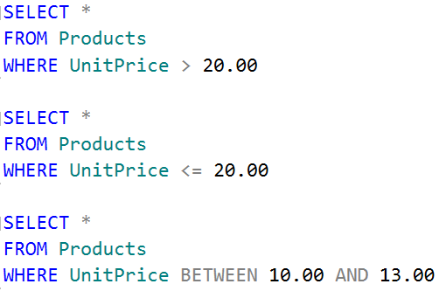
Numeric Ranges
Numeric ranges can be used to find data that falls under, over, or between values
You’ll notice if you run these queries that the between statement is inclusive (that means 10 and 13 are included in the results)

Slide 13

Two Part Identifiers
Sometimes (especially with keys) we will have the same named column in two different tables. In order for SQL Server to tell which column we actually want, we need to qualify it with the table name like so:

Slide 14
Lab Exercises
From the Orders table write these queries:
Select all the order information for the customer QUEDE
Select the orders whose freight is more than $100.00
Select the orders shipping to the USA whose freight is between $10 and $20

Slide 15
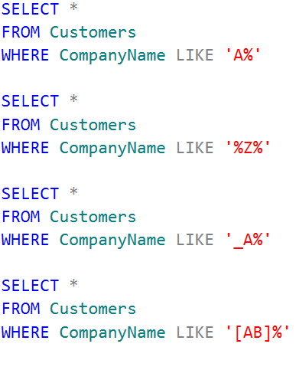
Pattern Matching
We can use the LIKE operator with a wildcard expression to do pattern matching on text fields.
% means any number of characters
_ (underscore) means exactly one character
[] square brackets can have a list of viable letters
(in MySql replace LIKE with REGEXP)

Slide 16
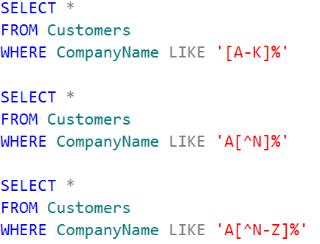
Some Other Pattern Tricks

Slide 17
Fin
Next up- Joining Tables!

